Slide 1
DDD, EF, WebAPI

Slide 2

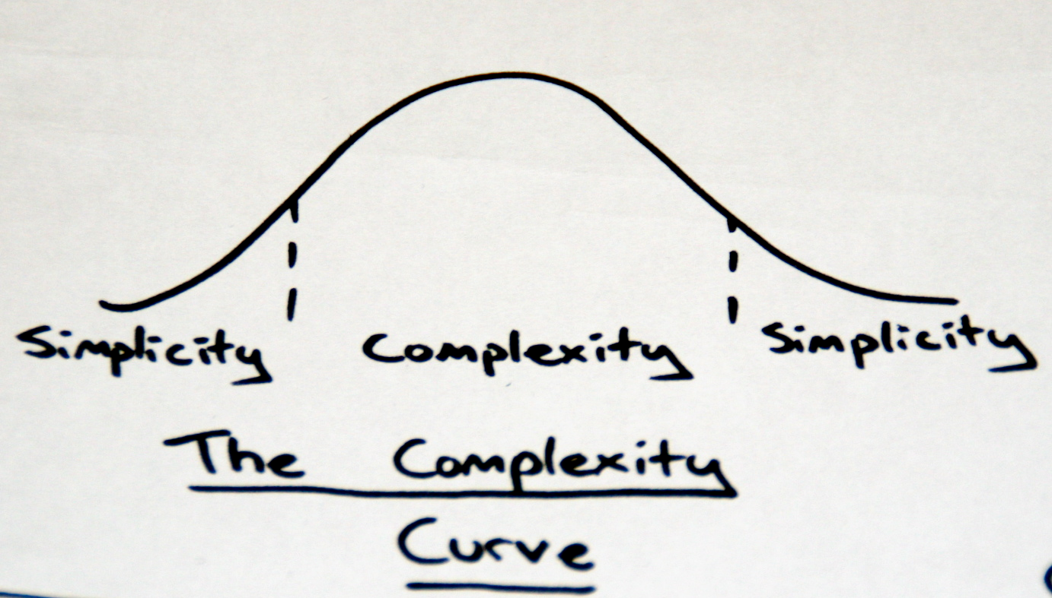
EF & DDD
Notes:
-Complexity =enemy
-Creeps in
-Affects ability to deliver
-Separate concerns
-Breaking into smaller units
-DDD is about distilling into an explicit model
-All in one place
-Easier to work with than sprocs/code behind

Slide 3
DDD
Koncepti
Patterns
Ubiquitous Language
Bounded Contexts
Persistance ignorance
Refactoring
CQS / CQRS
Kada upotrijebiti DDD?
Entities
Value objects
Aggregate roots
Repository
Domain Services
Domain Events
State
Notes:
- Aggregate je domain parrent koji definira vlasništvo i granice entiteta
- to je groupa povezanih entiteta koji djeluju kao jedan unit s obzirom na promjenu podataka

Slide 4

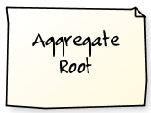







*
Aggregate root
Notes:
-Cannot hold reference to anything except the root
-Can’t access any entity except from the root
-Consistency boundary
-Save the whole thing
-Cascades
-Versioning
-Locking – coarse grain lock
-No longer cherry picking
- Aggregate je domain parrent koji definira vlasništvo i granice entiteta
- to je groupa povezanih entiteta koji djeluju kao jedan unit s obzirom na promjenu podataka
- root je entitet, jedini objekt koji se može pozvati izvana
- ako se prosljedi referenca na neki unutrasnji objekt, nesmije se koristiti nakon sto se operacija izvrsi

Slide 5
3-SLOJNA ARHITEKTURA
Presentation
Business Logic (BLL)
Infrastructure
Data Access (DAL)

Slide 6
ONION ARHITEKTURA
EmployeeController
IEmailSender
User Interface
G
Application Services
M
Database
Domain Services
IOrderProcessor
Services
Domain Model
File
system
Employee,
IEmployeeRepository
Tests
Infrastructure
etc
SmtpEmailSender
NHibernateEmployeeRepository
Notes:
-Domain model != view model
-The M in MVC
-Instead of depending downwards, dependencies goes inwards
The big difference is that any outer layer can directly call any inner layer
With traditionally layered architecture, a layer can only call the layer directly beneath it.
The application is built around an independent object model
Inner layers define interfaces. Outer layers implement interfaces
Direction of coupling is toward the center
All application core code can be compiled and run separate from infrastructure

Slide 7
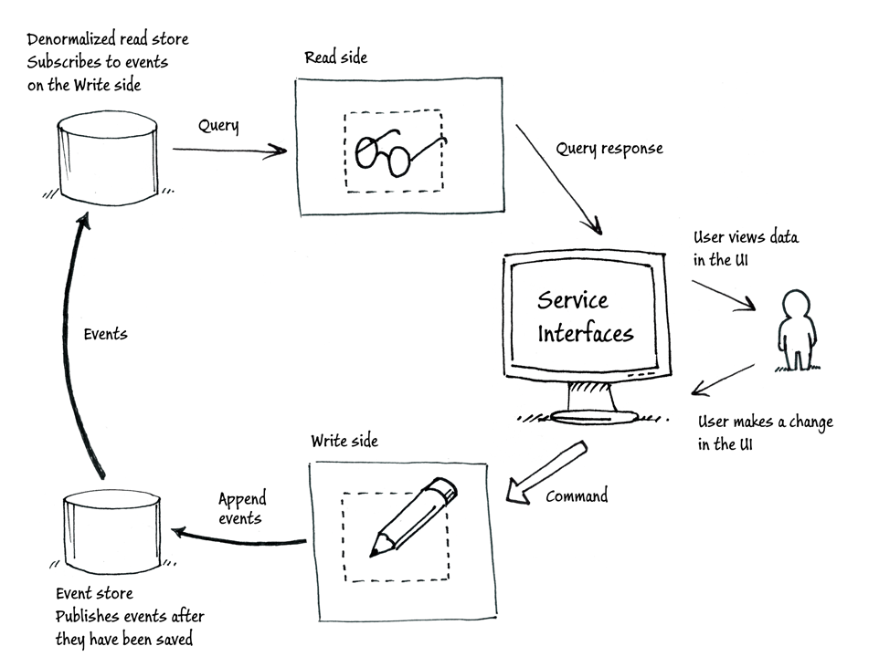

Slide 8
EF + DDD
Unit of Work
Privatni konstruktori
Privatni set-eri
Value objects vs Entities
Kompleksni tipovi
Repozitoriji vs. CQS

Slide 9
EF 6.1 NOVOSTI
DbContext
Enums, spatial
Code first
Migrations
Mappings, conventions
Multiple diagrams per model
Async, perf improvements, Connection Resiliency
Interceptors, custom configuratiomn, DI
Open sourced, out of .NET Fx
Nuget package + VS Tools addon download

Slide 10
„Any fool can write code that a computer can understand. Good programmers write code that humans can understand.”
Martin Fowler

Slide 11
WEBAPI
Zašto trebamo REST?

Slide 12
REST
Athitektura bazirana na HTTP protokolu i web principima
Vezana iskljucivo za HTTP
Lightweight
Stateless
Caching “out of the box”
Jednostavna konzumacija (mobile, JS)
Cilj: skaliranje, odvojenost komponenti, funkcionalnost izvan granica servisa

Slide 13
REST
CLIENT
GET /api/tickets/3
TICKETS
200 OK { title:”ticket name”,...}
POST /api/user { name:””, ...}
USERS
201 CREATED Location: /api/users/42

Slide 14
WebAPI
URL Routing
Convention routes
Attribute based routes
Content negotiation
IContentNegotiator
Accept: application/json, application/xml; q=0.9, */*; q=0.
Formats (JSON, XML, ATOM)
MediaTypeFormatter
Accept: text/html,application/xhtml+xml,application/xml
Self-hostable (OWIN based), testable, extensible

Slide 15
API CONTROLLER, ATTRIBUTE ROUTING
public class ProductsController : ApiController { public IEnumerable<Product> GetProducts() {...} public Product GetProductById(int id) {...} public HttpResponseMessage PostProduct(Product product) {...} }
[RoutePrefix("api/agents/{agentId}")]
public class ObservationsController : ApiController
{
// GET api/agents/bond/observations
[HttpGet("observations/{date}")]
public Observation Get(string agentId, DateTime date) { ... }
}

Slide 16
VALIDATION
public class Contact {
[Required]
public string FullName { get; set;}
[Email]
public string Email { get; set;}
}
if (!this.ModelState.IsValid) {
var errors = this.ModelState.Where(s => s.Value.Errors.Count > 0)
.Select(s => new KeyValuePair<string, string>
(s.Key, s.Value.Errors.First().ErrorMessage));
response = Request.CreateResponse(
HttpStatusCode.BadRequest, errors);
}

Slide 17
ODATA
The Open Data Protocol (OData) provides a RESTful standard for exposing data models
OData uses URIs to perform query operations:
Entity projection – $select, $expand
Sorting – $orderby
Entity sub-setting – $top, $skip
Filtering – $filter, logical operators: eq, ne, gt, lt
Install the Microsoft.AspNet.WebApi.OData NuGet package
Define an action with the following characteristics:
Returns IQueryable<T> or IEnumerable<T>
Decorated with the [Queryable] attribute

Slide 18
ODATA
[Queryable] public IQueryable<Agent> GetAgents() { return repository.GetAll().AsQueryable(); }
api/agents?$orderby=Name
api/agents?$skip=10
api/agents?$skip=50&$top=10
api/agents?$filter=salary gt 50000

